Slide 1
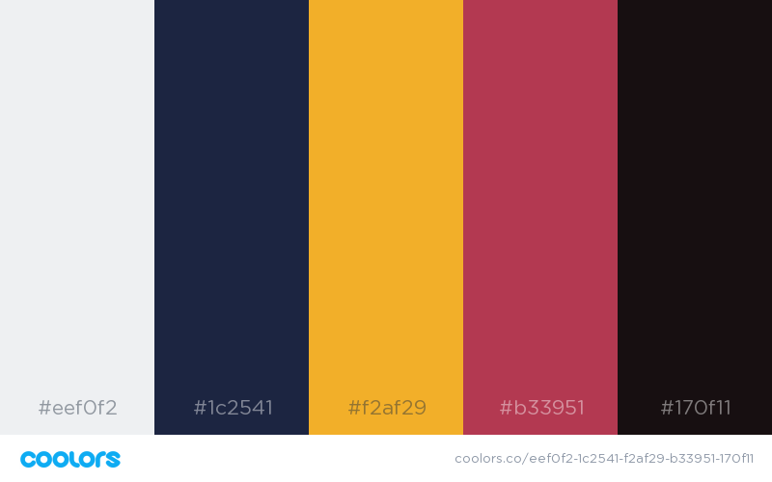

Slide 2
Classification Errors
For evaluating model performance

Slide 3
Example Situation

Slide 4
Example Situation
Definition of Confusion Matrix

Slide 5
Example Situation
Definition of Confusion Matrix
Applications of Confusion Matrix

Slide 6
Set-up:
Predictive Model for Cancer Detection
Sample of 100 patients

Slide 7
Set-up:
Predictive Model for Cancer Detection
10 have cancer
90 are healthy
Sample of 100 patients

Slide 8
Set-up:
Predictive Model for Cancer Detection
Your team must build a model that can predict if a patient from the sample has cancer (CASE) or if they are healthy (CONTROL)
10 have cancer
90 are healthy
Sample of 100 patients

Slide 9
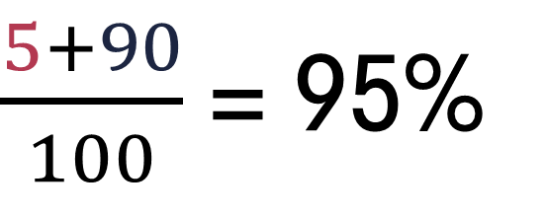
Our model correctly diagnosed 5 out of the 10 cases, while classifying the remaining 95 as controls….

Slide 10
Our model correctly diagnosed 5 out of the 10 cases, while classifying the remaining 95 as controls….
Classification Accuracy
The proportion of the sample that your model correctly classified

Slide 11
Model A
Model B

Slide 12
Model A
90%
Classification accuracy
Model B
89%
Classification accuracy

Slide 13
Model A
Diagnosed everyone as a control
90%
Classification accuracy
Model B
89%
Classification accuracy

Slide 14
Model A
Diagnosed everyone as a control
90%
Classification accuracy
Model B
Successfully identified 4 of 10 cases,
and 85 of 90 controls
89%
Classification accuracy

Slide 15
Type I Error:
Predicting that someone is a case when they are really a control

Slide 16
Type I Error:
Predicting that someone is a case when they are really a control
Type II Error:
Predicting that someone is a control when they are really a case

Slide 17
False Positive:
Predicting that someone is a case when they are really a control
False Negative:
Predicting that someone is a control when they are really a case

Slide 18
Model A
Diagnosed everyone as a control
90%
Classification accuracy
Model B
Successfully identified 4 of 10 cases,
and 85 of 90 controls
89%
Classification accuracy

Slide 19
Model A
Diagnosed everyone as a control
90%
Classification accuracy
Model B
Successfully identified 4 of 10 cases,
and 85 of 90 controls
89%
Classification accuracy

Slide 20
Model A
Diagnosed everyone as a control
90%
Classification accuracy
Model B
Successfully identified 4 of 10 cases,
and 85 of 90 controls
Type I Errors (FP): 0
89%
Classification accuracy

Slide 21
Model A
Diagnosed everyone as a control
90%
Classification accuracy
Model B
Successfully identified 4 of 10 cases,
and 85 of 90 controls
Type I Errors (FP): 0
Type II Errors (FN): 10
89%
Classification accuracy

Slide 22
Model A
Diagnosed everyone as a control
90%
Classification accuracy
Model B
Successfully identified 4 of 10 cases,
and 85 of 90 controls
89%
Classification accuracy

Slide 23
Model A
Type I Errors (FP): 5
Diagnosed everyone as a control
90%
Classification accuracy
Model B
Successfully identified 4 of 10 cases,
and 85 of 90 controls
89%
Classification accuracy

Slide 24
Model A
Type I Errors (FP): 5
Type II Errors (FN): 6
Diagnosed everyone as a control
90%
Classification accuracy
Model B
Successfully identified 4 of 10 cases,
and 85 of 90 controls
89%
Classification accuracy

Slide 25
Model A
Predicted Case
Predicted Control
Actual Case
0
10
0
90
Actual Control
Model B
Predicted Case
Predicted Control
Actual Case
4
6
Actual Control
5
85

Slide 26
In General
Predicted Case
Predicted Control
Actual Case
TP
FN
Actual Control
FP
TN
Don’t get confused if your table is ordered differently – you might have the first row be the actual cases rather than the control – that’s totally fine.

Slide 27
In General
Predicted Case
Predicted Control
Actual Case
TP
FN
Actual Control
FP
TN
Some useful metrics we can compute using these figures:
True Positive Rate/Sensitivity/Recall: TP / P
False Positive Rate/Fallout: FP/N
True Negative Rate/Specificity: TN/N
False Negative Rate: FN/P
Positive Predictive Value/Precision: TP/(TP + FP)
Negative Predictive Value: TN/(TN + FN)
The wiki article on Confusion Matrix is an excellent resource to review these concepts.

